Slide 1
Software Sales Pipeline Reporting
Presented by Jennifer Esharegharan

Slide 2

Presentation Outline
Objective
Data Sources
Reports Insights (Evidence and Interpretation)
Recommendations
Win Rate Analysis
Further Information
Conclusion

Slide 3

Objectives
To identify trends and patterns in our open software sales pipeline for 2021, which would help us gauge the health of our software sales pipeline, improve our leads conversion, increase our software sales pipeline dollars and profitability.
To analyze our win rates associated with the Closed opportunities for 2018, 2019 & 2020 Year to date, in order to improve customer acquisition and retention strategies, and drive annual revenue growth.

Slide 4


Data Sources
Software Sales Pipeline Forecast Data for 2021 from our Salesforce CRM
Historical software sales pipeline data from our Salesforce CRM

Slide 5
Reports Insights (Evidence & Interpretation)
Open Software Sales Pipeline Reporting for 2021.

Slide 6
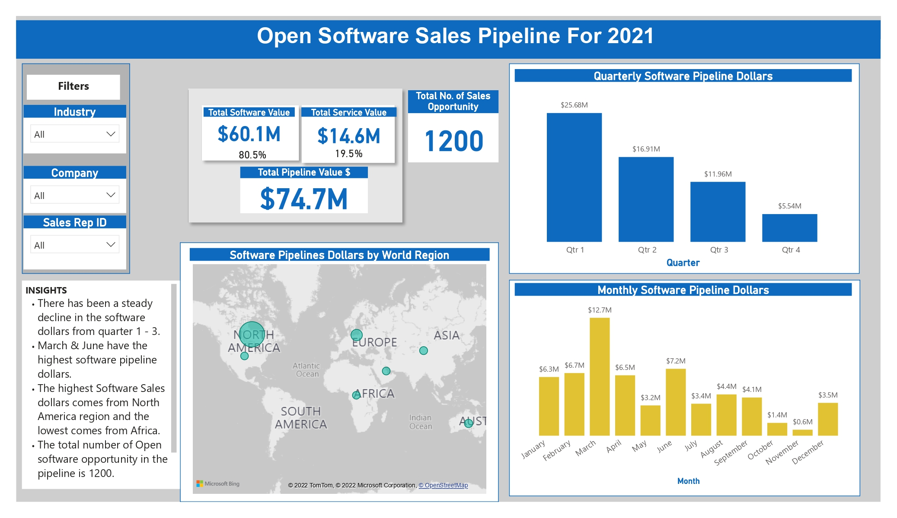
Presentation Outline

Slide 7
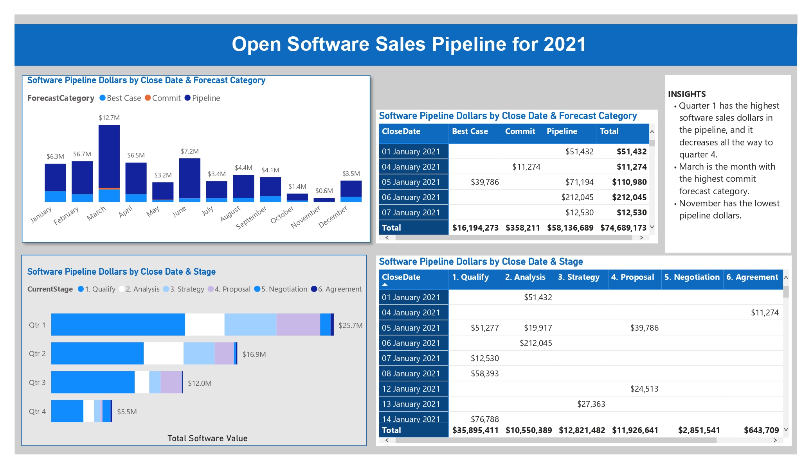
Presentation Outline

Slide 8
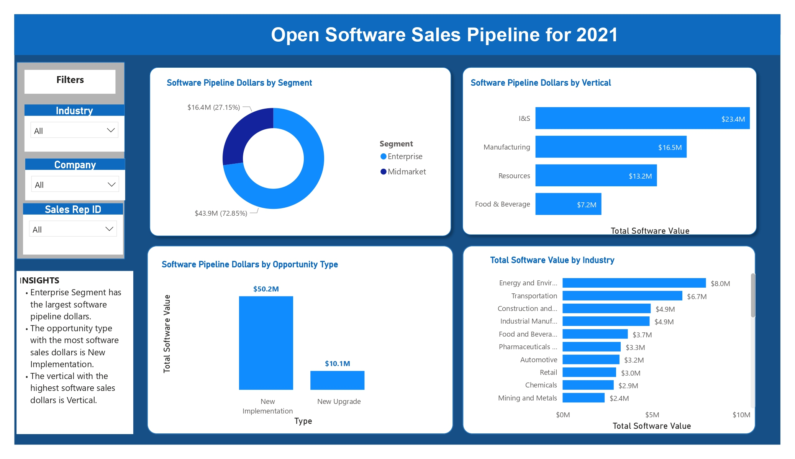
Presentation Outline

Slide 9
Insights
Our software sales Pipeline shows that the total software value for 2021 is $60.1million dollars, our total service value is $14.6million and our total pipeline value is 74.7million.
Our software value makes up 80.5% of our total pipeline value and service value makes up 19.5% of our total pipeline value.
The total number of Open Sales opportunity in 2021 is 1200.
There’s a downward linear trend in our software pipeline dollars. This doesn’t look very good for our business as it means our performance will depreciate by quarter in 2021.
Going by this, quarter 1 is our best quarter for the year.
March is forecasted to be our best month, followed by June and February.
November is our least performing month, followed by October.
North America has the highest software revenue, followed by Europe.
Africa has the least.

Slide 10
Insights
The aim of this report is to help us look ahead and strategize for the next fiscal year.
Need to further investigate why our software value would decline in the 2nd , 3rd and 4th quarter.
In the months where we have high sales value, what did our sales and marketing team do? And what did they do differently in the other months?
We need to check if there are seasons associated with our industry and our sales.
Are the looking at our total software value and total service value, we need to look at what our software and service value targets are.
Also, are these figures close to what we are targeting for 2021 or is there a great disparity?

Slide 11
Insights
In quarter 1 we had a software value of $12.2m in the qualify stage and by the Negotiation stage, we had only about $291,000. Showing that our software value in the Agreement stage is 2.4% of our software value in the qualify stage.
In quarter 2, we had a software value of $8.5m in the qualify stage and by the time the leads got to the agreement stage, the software value had reduced to about $118,000.
That is, our software value in the Agreement stage is 1.4% of the software value in the Qualify Stage.
In Quarter 3, our software value in the Agreement stage is 0.5% of the software value in the Qualify Stage.
And finally, by quarter 4, our software value in the Agreement stage is 5% of the software value in the Qualify stage.
All of these show a steady decline in our software sales value by quarter.

Slide 12
Insights
In the dataset provided, the software value target or sales target is not provided and as such, it is impossible to say if with the low conversion and the drastic decline in our software dollars we are able to meet our target and be profitable.
Looking at the software value annually, we see that the software value dollar in the Agreement stage is 1.8% of the software value dollars in the Qualify Stage.
This means annually, only about 1.8% of the software value from the Qualified leads get to the Agreement stage.
It seems safe to say that we need to critically review our sales processes.

Slide 13
Insights
Our open forecast categories usually move from Pipeline to Best Case and then Commit.
Our data shows that the bulk of our software value is in the pipeline as is to be expected, and we lose well over 50% of software dollars by the time we move leads from pipeline to best case. We lose even more leads as we move to commit.
Our data shows we have less than 1% of leads in commit in the different months. This is alarming and our sales strategies need to be improved upon.
The matrix visual on my right shows that by the end of 2021, our cumulative software pipeline dollars would be $74.7m and it is broken down into $58.1M in Pipeline, $16.2m in Best case and approximately $358,000 in commit.
Which shows that of our total software value, pipeline is 77.8%, Best Case is 0.5% and Best Case is 21.7%.
Also, only 0.6% of software value in the pipeline progresses to Commit.

Slide 14
Recommendations
Having looked through the data and seeing how much leads get lost in the pipeline, I recommend the following:
Our sales processes are re-evaluated for inefficiencies.
The health of our sales pipeline should be maintained by continously adding the required leads to the pipeline as well as removing dead end leads once confirmed.
Pipeline coverage goals should be established with the sales team for every quarter.
Our sales and marketing team should be aware of our pipeline coverage and know how to use it to close more software sales deals.
Identify the commonalities between opportunities that convert at each stage of the pipeline. Check the actions of the sales rep in each of these stages and use them as learning points for others.
Let’s check our standard follow up processes throughout our pipeline
Customer analysis to further identify their pain points, needs and to better understand how we can meet these needs.
Training for our sales team

Slide 15
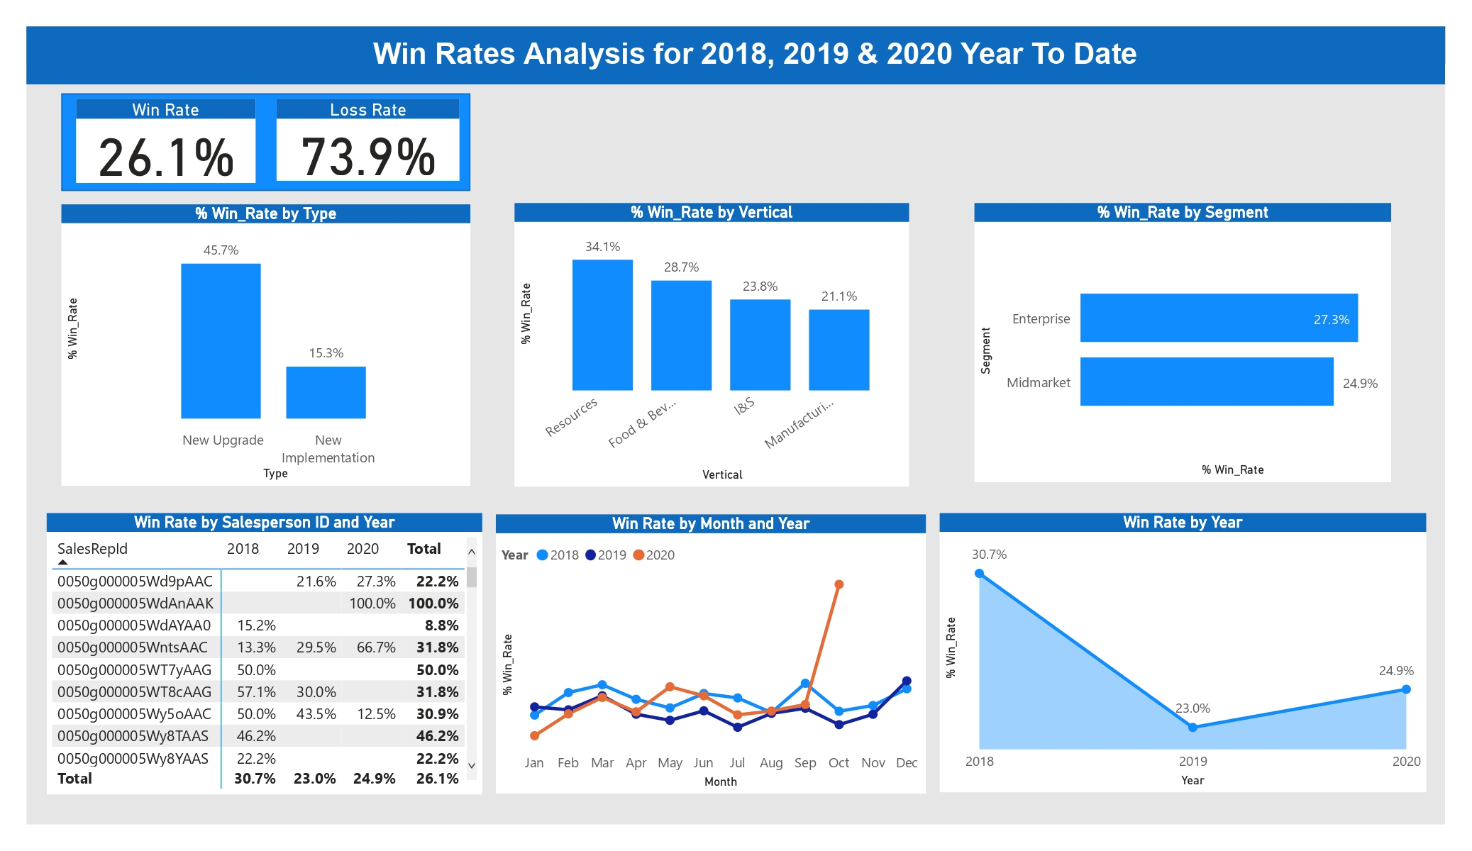
Insights

Slide 16
Win Rates Analysis
The aim of this win rate analysis is to capture the reasons why we lost and won sales opportunities in our pipeline, in order to improve win rates and attain our sales targets.
Trends Observed
Win Rate by Sales Opportunities Count asks the question ‘How often do I win?’ To answer that, the data says ‘30.7%’ in 2018’, 23.0% in 2019 and 24.9% in 2020
2018 has the highest win rate of all three years. There was a deep by 7.7% fall in the win rate by 2019 and by October 2020, the win rate had risen to 24%.
There seems to be a seasonal trend in the months of 2018, 2019 and 2020. However, in October 2020, there was a sudden spike in the win rate.
Of all the verticals, Resources has the highest win rate while manufacturing has the lowest win rate.
At 27.3% win rate, Enterprise leads Midmarket segment

Slide 17
Recommendations
Our sales team, in collaboration with the marketing team, can increase the marketing of Verticals, which have higher win rates like Resources, Food & Beverage, while upgrading the current strategies for the verticals with lower win rates.
Investigation should be carried out to discover the cause of the reduction of 2019 win rates. Also, the sales and marketing strategies that were used in 2018 when the win rate was high, should be reviewed. If it’s the same strategy and sales process from 2018, then it means it is no longer effective and needs an upgrade. If there is a current change in strategy from what was done in 2018, comparison should be made to see what insights could be gotten.
Salespersons who have consistently outperformed their peers in 2018, 2019 and 2020 should share their sales pipeline process during strategy sessions so key aspects can be integrated in the team’s strategy.
Salespersons who have very low win rates need further sales training and should be placed on a performance improvement plan.

Slide 18
Further Information Needed
The following information would have helped improve the quality of my analysis:
Target Software Sales Revenue/Value (monthly and annually): This would be useful for calculating pipeline coverage ratio so as to ensure we have enough leads in our pipeline at every point in order to achieve the sales target. Not having the sales target makes it difficult to ascertain if we should double down or on our sales activities.
Competitor Information: This would help in conducting a competitor analysis.
Customer data/ Analysis: This would give more insights to our low conversion rate.
Information on the marketing channels: To measure conversion rate by channel which would help the sales and marketing team better understand their pipeline.

Slide 19
Conclusion
Having gone through our sales pipeline data, the following key points are clear:
Our sales team needs to re-evaluate their sales processes and sales pipeline to identify the causes of the huge leaks and develop with new strategies to reduce the leaks.
If provided with more data, I would be glad to support the team in achieving their goals for 2023.
Thank you.

